Slide 1
Subthalamic GAD Gene Therapy in a Parkinson’s Disease Rat Model
Jia Luo,Michael G. Kaplitt, Helen L. Fitzsimons, David S. Zuzga, Yuhong Liu,Michael L. Oshinsky, Matthew J. During

Slide 2
Parkinson’s Disease
Degenerate disease of the nervous system that affects movement
Affects over 50,000 Americans each year
Symptoms: tremors, muscle rigidity, speech change, bradykinesia (limited movement), gait and balance disturbance, decreased dexterity and coordination, digestion and urinary problems, increased sweating, low blood pressure, muscle and joint cramps

Slide 3
Onset: 50-60 years old
Treatment: no known treatment
  Medications are used to relieve symptoms
    Levadopa, MAO B inhibitors, COMT inhibitors
  Surgery is sometimes affective
    Deep brain stimulation
    Pallidotomy
    thalamotomy
  Lifestyle adjustments
    Physical, occupational, speech and language therapy

Slide 4
What we know about Parkinson’s Disease
Caused by death of dopaminergic neurons in the Substantia Nigra pars Compacta
Thalamic activation of upper motor neurons in the motor cortex is less likely to occur
The inhibitory outflow of the Basal Ganglia is significantly higher
  Basal Ganglia is required for the normal course of voluntary movement

Slide 5
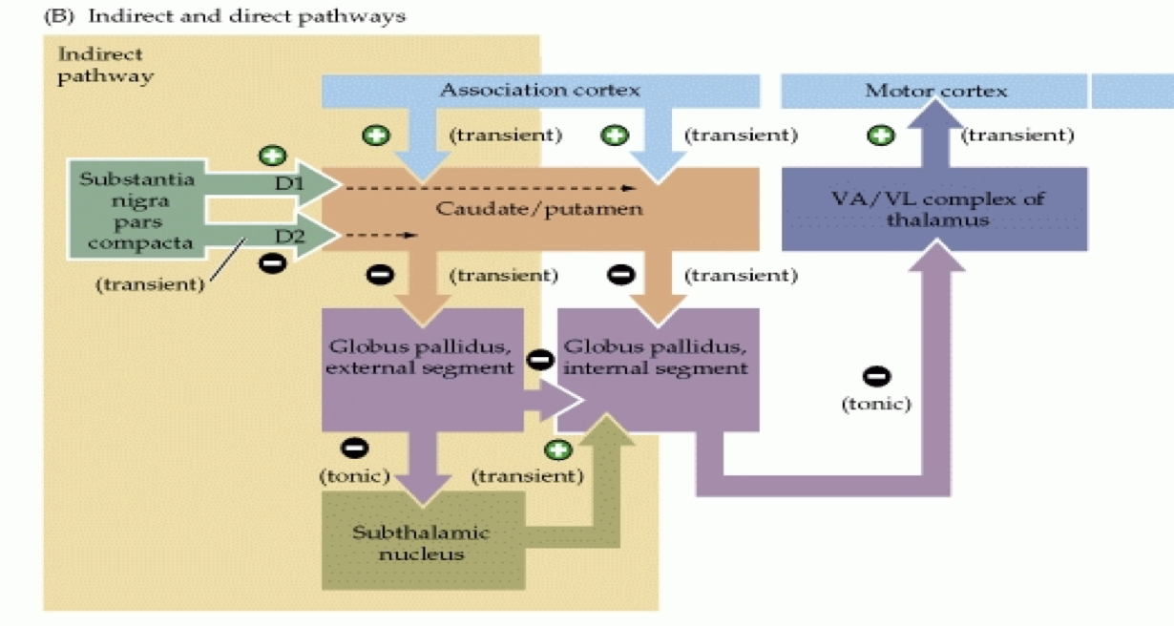
THE BASAL GANGLIA
Indirect pathway – modulates the disinhibition actions of the direct pathway
Direct pathway activated reduces inhibition
Inputs provided by SNC are diminished in PD making it more difficult to generate the inhibition from the caudate and putamen.
SNPR
PD: The disinhibited STN is overactive now and sending excitatory signals to the SNr and Gpi.
Notes:
This is a diagram of the different components that make up the basal ganglia. There is a direct pathway and an indirect pathway. The positive and negative signs represent excitatory and inhibitory signals respectively. The direct pathway receives a signal from the cortexwhich then ultimitely disinhibits the thalamus which at rest is usually inhibited – so the thalamus sends the signal to the motor cortex. The indirect pathway modulates the disinhibition actions of the direct pathway and this pathway is what is disrupted in parkinsons. On the last slide I said that we know in PD is caued by the death of dopaminergic neurons in shte SNPC. Since these inputs are now diminished in PD ( representeed by the dashed lines) it makes it more difficult to generate the inihibition from the caudate and the putamen. This now ultimately enhances the inhibition on the thalamus so no signal is being sent. This is because now the subthalamic nucleus can send an excitatory signal when there shouldn’t be one. The article im presenting concentrates on that excitatory connection between the STN and the SNPr which you could imagine is whre the Gpe is.

Slide 6
Previous studies
Deep brain stimulation of the STN or GPi is associated with significant improvement of motor complications in patients with Parkinson's disease given about a year of treatment.
Triple transduction expressing tyrosine hydroxylase, l-amino acid decarboxylase, and GTP cyclohydrolase I for gene therapy
Injected vector encoding neurotrophic factor (GDNF) that supports growth and survival of dopaminergic(DA) neurons, into a rats substantia nigra
Notes:
2.These enzymes are all involved in the biosynthetic pathway for dopamine.
3. The study resulted in an increase level of dopamine

Slide 7
Hypothesis of the Study
“Glutamatergic neurons of the STN ( subthalamic nucleus) can be induced to express GAD, and thereby change from an excitatory nucleus to a predominantly inhibitory system that releases GABA at its terminal region in the substantia nigra (SN), leading to the suppression of firing activity of these SN neurons.”
Glutamate = excitatory neurotransmitter
GABA = inhibitory neurotransmitter

Slide 8
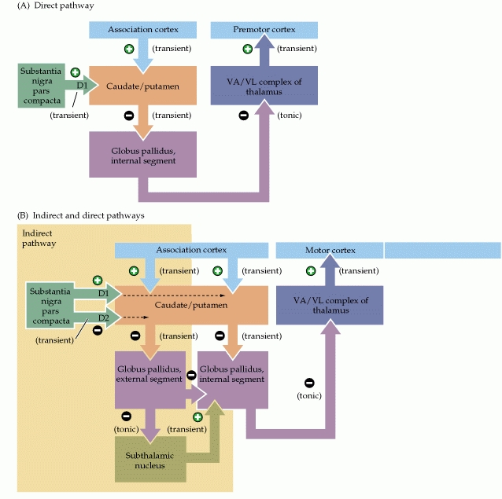
CHANGE FROM EXCITATORYTO INHIBITORY
GAD

Slide 9
The study also showed…..
This intervention also resulted in protection- resistance to 6-hydroxydopamine ( 6-OHDA) .
6-OHDA
  A neurotoxin that scientists commonly use
  Induces degeneration of dopaminergic neurons

Slide 10
How were the STN neurons induced to express GAD?

Slide 11
rAAV ( recombinant adeno-associated virus) to transduce the neurons
Why this vector?
  stable gene transfer
  Highly efficient
  Minimal inflammatory and immunological responses
GABA can be generated by two isoforms of GAD, GAD65 and GAD67.
Generated multiple vectors containing GAD65 and GAD67 cDNA
  Used the CBA promoter and a woodchuck hepatitits virus postregulatory element

Slide 12
Functional expression of transgene confirmed
Mouse neural cells (C17.2) were transduced with both of the isoforms of GAD
Expression confirmed by immunocytochemistry
  Antibodies were specific to GAD65, GAD67, GABA
  Remember : GAD converts glutamate to GABA so an excitatory neurotransmitter to an inhibitory neurotransmitter
HPLC (high-performance liquid chromatography) used to measure GABA release

Slide 13
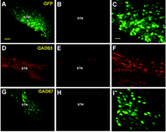
Adult male rats were injected with either GAD65, GAD67 or a control GFP vectors into their left STN
Determined expression of transgene 5 months after the injections
  Results: expression was isolated in the STN for all transgenes
Notes:
GFP and GAD67
filled the entire cell
Body
GAD65 had a nuclear
halo in the neurons
with a membrane-
bound enzyme

Slide 14
Testing the hypothesis
Control – unlesioned rats
6-OHDA-lesioned parkinsonian rats received
  GAD65, GAD67, GFP, or saline
Used Microdialysis and electorphysiology -- electrode STN, probes SNr (Substantia Nigra pars reticulata)
  Remember: the STN neurons has its’ excitatory dendrite terminals on the SNr
Measured GABA and glutamate concentrations
Notes:
microdialysis is the only sampling technique that can continuously monitor concentrations in any tissue

Slide 15
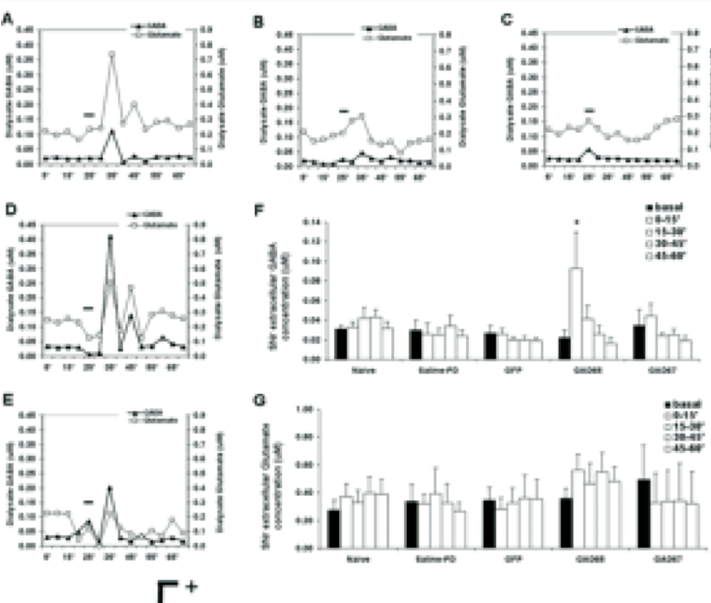
RESULTS
Glutamate – light line
GABA – dark line
A-unlesioned D-GAD65
B-saline E-GAD67
C-GFP
Unlesioned, saline, GFP rats – No significant increase in either neurotransmitter
GAD65 – 4 fold increase in GABA release
GAD65 GABA INCREASE

Slide 16
Further Testing of the Hypothesis….

Slide 17
Took a subgroup of rats and placed recording electrodes in the STN AND the SNr
STN was stimulated then the SNr cells were recorded
RESULTS:
  Unlesioned rats – excitatory responses in 74% of SNr cells, 5% inhibitory
  GFP and saline parkinsonian rats – 83% excitatory, 6%, 10% inhibitory respectively
  GAD65 – 17% excitatory, 78% inhibitory
  GAD67 – 62% excitatory, 33% inhibitory
Notes:
STN → normally excitatory glutaminergic synapsis → SNr
Makes sense since there is no GAD expression so the synapse is still excitatory

Slide 18
Examined other effects of GAD expression
Carried out a similar experiment with surgery for rats to receive GFP, saline, or GAD isoforms
6-OHDA was injected 3 weeks after surgery the medial forebrain bundle
Fluorogold was injected as well to show neuronal degeneration
RESULTS: GAD65 – 35+/- 14% dopmainergic neurons survived in SNc and 80+/-11% survived in VTA ( ventral tegmental area- origin of dopaminergic cell bodies)
  GAD67- less than 1% survival

Slide 19
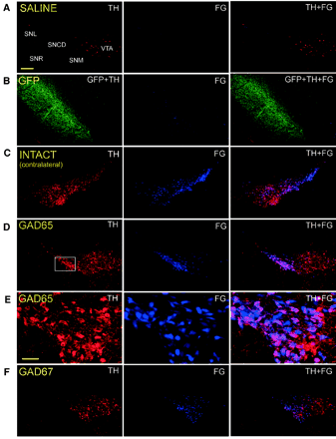
TH – tyrosine hydorxylase
  Enzyme that catalyzes the conversion L-tyrosine to DOPA
  DOPA is a precursor for Dopamine
FG – fluorogold

Slide 20
CONCLUSIONS
Transfer of the gene GAD into cells in the STN resulted in a phenotype change from excitatory to inhibitory transmission.
  GAD65 is the more effective isoform
  GAD67 expressed an intermediate phenotype
GAD65 offers nigral neuroprotection

Slide 21
Future Application
The coupling of GAD gene transfer resulting in an inhibitory network and neuroprotection can potentially treat Parkinson’s Disease as well as many other neurological conditions that are characterized of having over expressed excitatory synapses.

