Slide 1
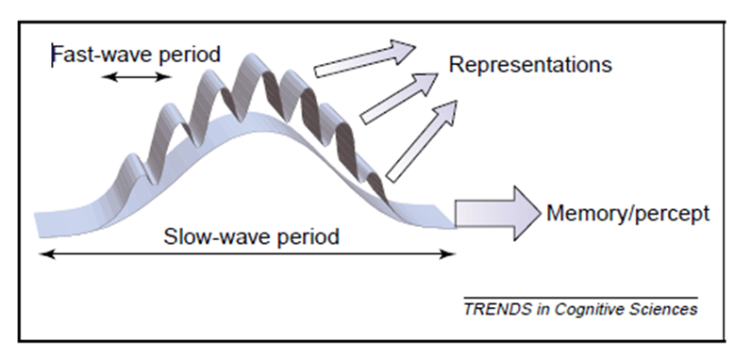
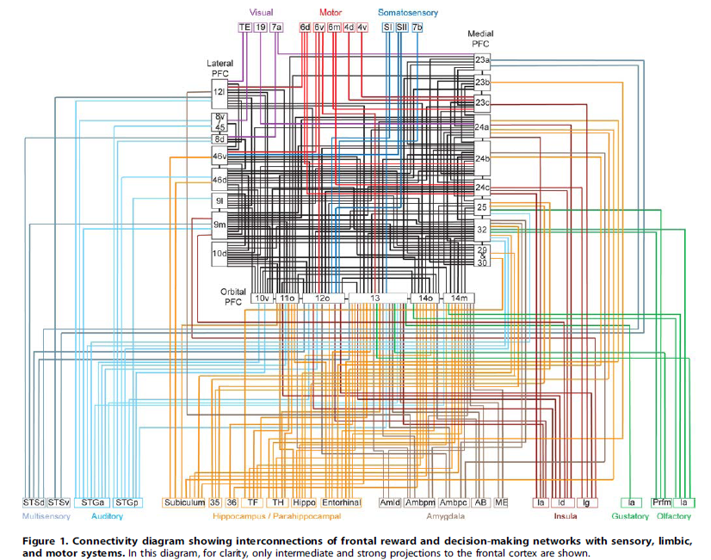
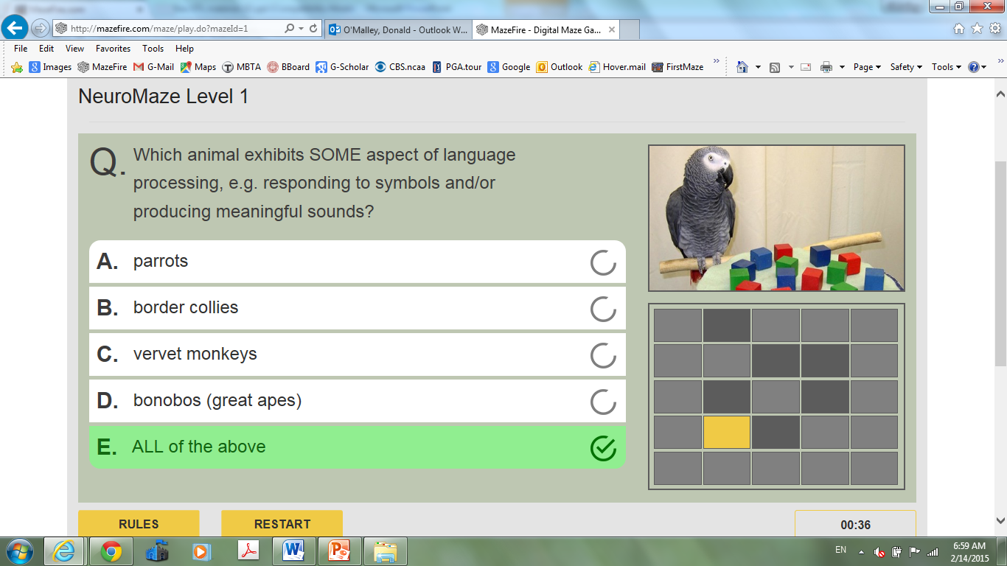
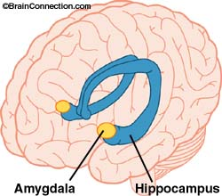
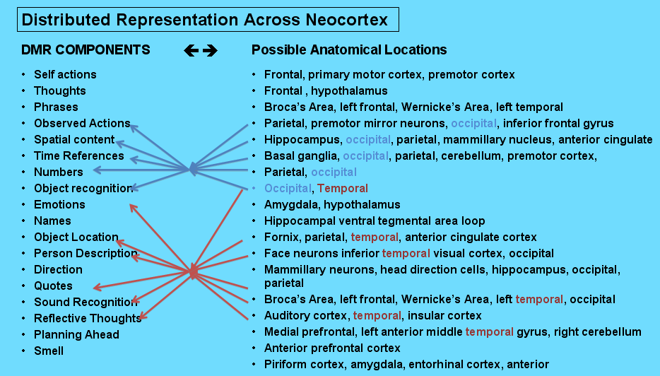
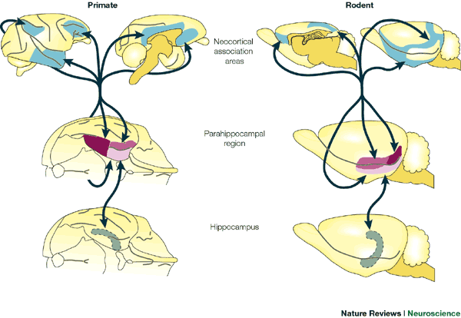
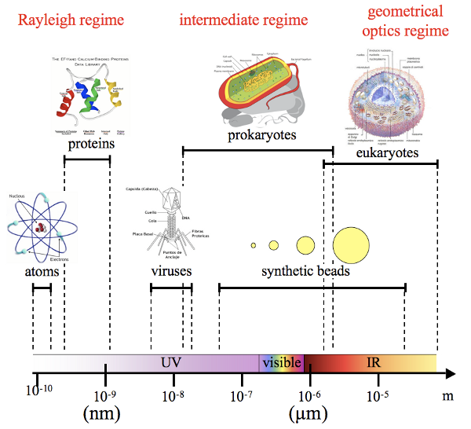
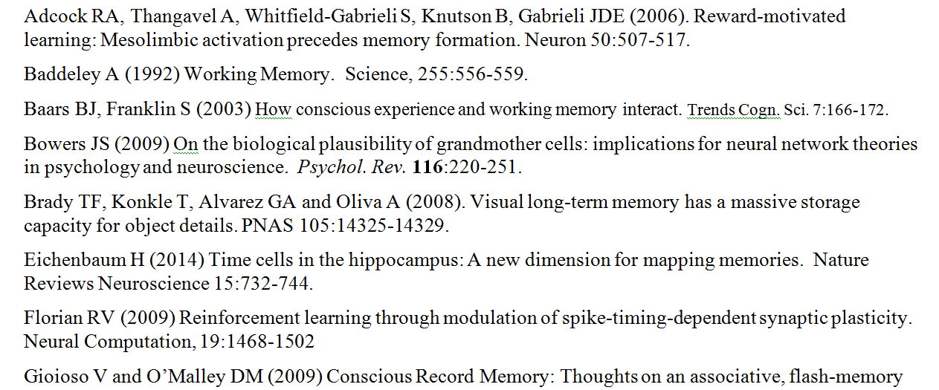
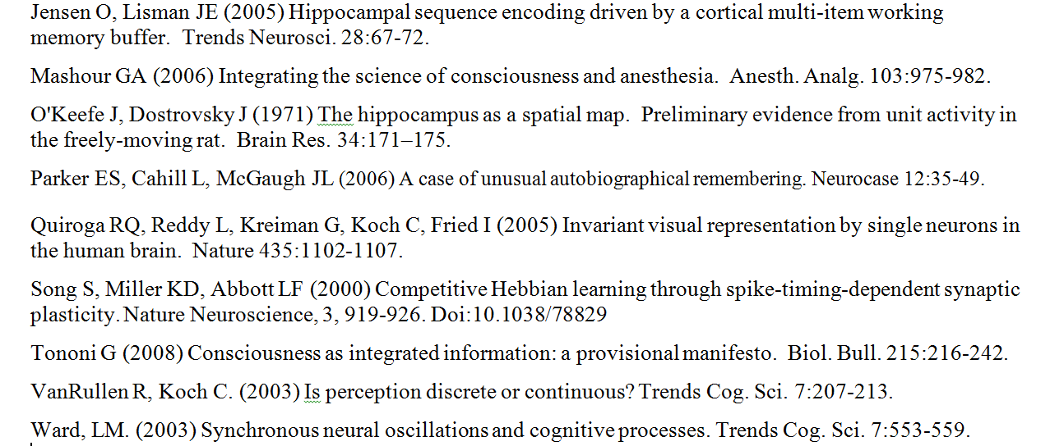
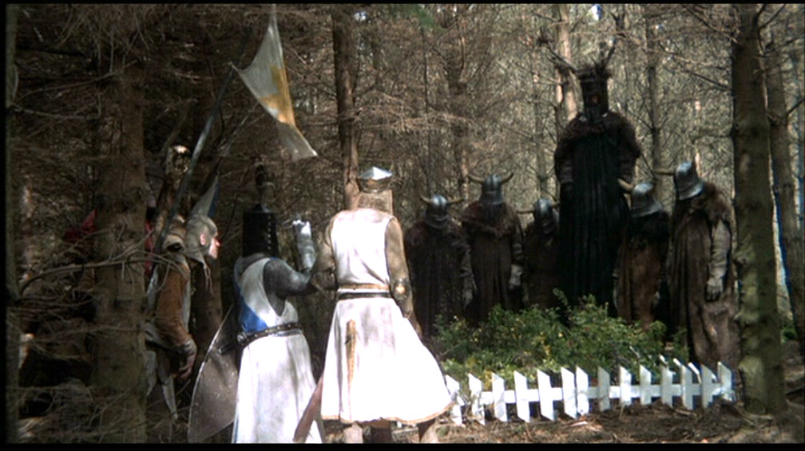
Live Long
and
Prosper
2. WHAT do Neural Representations Look Like?
- more likely distributed than grandmother-cell like
- flexible, reliable and multi-sensory
- associated with gamma, theta and alpha rhythms
i.e. associated with synchronous neural activity
- “sparse” perhaps, but might actually be quite dense
- human temporal lobe neuron responded only to pictures
of Jennifer Aniston (Quian Quiroga et al., 2005, Nature)
2015 NURDS Conference
University of New England
Biddeford ME, 3/8/15
STREAM OF
CONSCIOUSNESS
DMR
6. How is Knowledge Represented?
- invariant representations of knowledge tokens
- distributed, massively interconnected assemblies
- “dense coding” ala Quiroga’s Jennifer Aniston cells
- symbolic “neural words” (~ neural “PDFs”)?
- Knowledge Architectures built of atoms, molecules,
to larger structures (proteins, cells, by analogy)
1. Why is there no Flow Chart from Neural
Representation to Knowledge Integration?
Details on Neural Representation are presently sketchy, so it is difficult to chart a path whereby new items become integrated into our still mysterious knowledge architectures. We highlight here some key obstacles along with thoughts on how they might be addressed.
INTEGRATED
PERCEPT
3. WHERE are Neural Representations Located?
- working memory strongly involves prefrontal cortex (PFC)
but PFC-hippocampal connections are also prominent
- one trial learning in hippocampus-amygdalar complex
shown for “novel” and “familiar” cells (Rutishauser et al. 2006)
- locations are best guesses based upon sparse information
- both locus & nature of most neural codes are largely unknown
CGM / FILTER
200 msec to
consciousness via
gamma oscillations
Memory Storage via γ on θ rhythms, Lisman & Idiart, 1995
consciousness-
generating
machinery
Bruno Averbeck &
Moonsang Seo, 2008
Are DMRs stored in the temporal / parietal / prefrontal cortices?
SENSORY INPUTS
neocortical SIGNALS
PLoS Computational Biology
Olshausen and Field, 2004, Curr. Opin. Neurobiology
Bottom-Up
Top-Down
10. Can Active Learning Help?
- extrinsic motivation boosts synaptic activation
- amplified by intrinsic motivation of games, case studies
- neuronal summation (multisensory, connections) ➔ LTP
- active learning facilitates knowledge integration
- SLT framework might inspire new A.L. approaches?
V1 neuron’s response becomes more selective in context of a natural scene
Bruno Averbeck &
Moonsang Seo, 2008
PLoS Computational Biology
4. What do DMR epochs look like?
- trans-cortical representations (see items #6, #8)
- binding depends on alpha & gamma-band oscillations?
- largely non-linguistic in nature: “knowledge tokens”
PFC is a massive hub. Are DMRs stored in the temporal / parietal / prefrontal cortices?
Rutishauser et al.
2006, Neuron.
4. HOW does NEW knowledge enter our brains?
- some enters via Working Memory in Prefrontal Cortex
- but most is Long Term Memory, requires hippocampus
see e.g. LTP, patient HM; but location of EM buffer is uncertain
- all Declarative Knowledge passes through Conscious
Experience and Daily Memory Records (DMRs)
10. HOCs Rock! [Higher Order Correlations]
- within DMRs (correlations between DMR epochs)
- SCIP scanning of knowledge architectures for best fits
- roles for hippocampus, Bayesian inference? J. Tenenbaum
- percolation theory and Auto Associative Networks
- cortical proofreading mechanisms (www.syndar.org)
VISIT: www.mazefire.com for
neuro, bio, physiology games
Rat Hippocampus
Santiago Ramon y Cajal
DMR Items, Frequency of Item Occurrence
Diagram illustrates trans-cortical connectivity and emphasizes prefrontal
cortex as a massive hub through which all manner of representations might bind.
Ganz and O’Malley, 2012
@ www.zfhindbrain.com
See Quian Quiroga et al. 2005
Knowledge Acquisition, Integration and Reward:
a Neuronal / Synaptic Perspective of STEM Learning
Annie G. Bryant AND Donald M. O’Malley
Behavioral Neuroscience Program & Dept. Biology, NU, Boston MA
4. What do DMR epochs look like?
- trans-cortical representations (see items #6, #8)
- binding depends on alpha & gamma-band oscillations?
- largely non-linguistic in nature: “knowledge tokens”
8. How is NEW Knowledge Integrated?
- role of SCIP ϟ Sub-Conscious Information Processing
- valuation of connections in trans-neuronal representations
- expansion and enrichment of Knowledge Architectures
- how are new CONCEPTS created?
- role for Symbolic Neuronal Operations (SNOPs)?
- percolation for Pavlovian-connections & processing?
Digital Maze Games use Intrinsic Motivation to boost synaptic learning
MEDscience cases are Active and Multi-Sensory
STREAM OF
CONSCIOUSNESS
DMR
DMR Items, Frequency of Item Occurrence
In education, Big Data is all about finding multivariate correlations and using that to improve learning and teaching outcomes: this is called evidence-based teaching or learning. But this does not explain how we learn. In our extension of Synaptic Learning Theory (SLT), we seek a path to a more principled understanding of the neural processes that acquire and integrate knowledge, as well as the nature of mammalian knowledge architectures. Advancing learning science without these principles might be akin to advancing molecular biology without knowing what codons are or what restriction enzymes do. Linking KA’s to synaptic events could take 100 years or more, but could have far-reaching ramifications. Coming soon: Synthetic Neuroscience Institute: d.omalley@neu.edu
INTEGRATED
PERCEPT
200 msec to
consciousness via
gamma oscillations
Consc. Epochs see VanRullen & Koch (2003); Alpha/Gamma see Ward (2003) in Trends in Cogn. Sciences
CGM / FILTER
consciousness-
generating
machinery
Consc. Epochs see VanRullen & Koch (2003); Alpha/Gamma see Ward (2003) in Trends in Cogn. Sciences
SENSORY INPUTS
neocortical SIGNALS
Ganz and O’Malley, 2012 @ www.zfhindbrain.com
Bottom-Up
Top-Down
5. What exactly DO we RECORD and SAVE?
- “salience / novelty” = first pass “filter” into SoC
- from SoC, 2nd filter evaluates and stores epochs
- of ~ 15,000 epochs per day (= 1 DMR) only a small
subset are consolidated into long-term memory
- epochs might be assigned value by comparison to
stored, related items = 3rd filter
- subconscious IP, sleep & hippocampus all contribute
Ganz & O’Malley, 2012
9. How does Language relate to Knowledge?
- words, by themselves, mean nothing
- words and phrases: just “tags” for non-linguistic items?
- universal grammar is built upon universal physics
aka evolutionarily deep objects, actions, relationships
- language offers fully symbolic operations, BUT
- sub-linguistic SNOPs might entail massive SCIPs
see On Intelligence (Hawkins) and Baars & Franklin (2003, 2005, 2007)
5. How do WM contributions differ from DMRs?
- WM holds 7 +/- 2 items (see Lisman & Idiart γ on θ model)
- DMRs are largely non-linguistic in nature: “knowledge tokens”
WM is repetitive and effortful vs. the 1-trial, no effort DMR writing mechanism that might store thousands of items. Both entail conscious states, but they seem rather different!
Pulvermüller & Fadiga, 2010, NRN
Complementary Learning Systems:
Primate Medial Temporal Connections
McClelland, McNaughton & O’Reilly, 1995
8. How is NEW Knowledge Integrated?
- role of SCIP ϟ Sub-Conscious Information Processing
- valuation of connections in trans-neuronal representations
- expansion and enrichment of Knowledge Architectures
- how are new CONCEPTS created?
- role for Symbolic Neuronal Operations (SNOPs)?
- percolation for Pavlovian-connections & processing?
Consc. Epochs see VanRullen & Koch (2003); Alpha/Gamma see Ward (2003) in Trends in Cogn. Sciences
Bound items in DMRs relate to diverse, trans-cortical representations involving
many parts of neocortex. Hippocampus might sequence epochs via γ on Φ rhythms.
6. Atoms to Organisms: Learning by Analogy
- Exemplar STEM Knowledge Architecture (KA): Biology
atoms, molecules, DNA, cells, organisms, clades … LIFE
- KAs are often analogous to other KAs (network duplication?)
- Universal Physics (objects, actions, properties) shaped the
evolution of CNS, neocortical architectures
- Theoretical model of Knowledge Integration (e.g. Hinton,
1986) has no clear correlate in neocortical systems
Howard Eichenbaum
Nature Reviews
Neuroscience, 2000.
7. How does Language relate to Knowledge?
- words, by themselves, mean nothing
- words and phrases: just “tags” for non-linguistic items?
- universal grammar is built upon universal physics
aka evolutionarily deep objects, actions, relationships
- language offers fully symbolic operations, BUT
- sub-linguistic SNOPs might entail massive SCIPs
Cortical-
Hippocampal
System for
Declarative
Memory
see Rilling et al. 2008,
Nature Neuro. 11:426.
HOCs Rock! Higher Order Correlations
- within DMRs (correlations between DMR epochs)
- SCIP scanning of knowledge architectures for best fits
- roles for hippocampus, Bayesian inference? J. Tenenbaum
- percolation theory and Auto Associative Networks
- cortical proofreading mechanisms (www.syndar.org)
From Stream of Consciousness (SoC) we RECORD into DMRs
Excerpts of DMRs are SAVED into Long Term Memory (LTMs)
Rats store contextual LTMs that require an intact hippocampus
Do rats have DMRs? Just ask one! or see Eichenbaum and Fortin, 2003
Most learning/memory is Hebbian, but this requires coincident firing
Rilling showed, in humans, enhanced trans-cortical STS connectivity which might facilitate fully symbolic neuronal operations (SNOPs) aka Language.
The number of possible sentences vastly exceeds the number of words. By analogy, the number of knowledge architecture constructs vastly exceeds the number of “stored” working memory tokens.
Pulvermüller & Fadiga, 2010, NRN
7. How do α, θ and γ Rhythms Contribute?
- γ (gamma) rhythms underlie conscious experience
- γ on θ rhythms enable working memory (WM)
- synchrony amplifies signals, LTP & STDP (plasticity)
- coupled oscillators might link DMR items
- memory recall depends more on θ than on α-rhythm
- rhythms intensify upon learning, decision making
see e.g. Benchenane et al. 2010, Kendrick et al. 2011, Watrous et al. 2015.
Suggested Readings
Bound items in DMRs relate to diverse, trans-cortical representations involving many parts of neocortex. Hippocampus might sequence DMR epochs via γ on Φ rhythms.
From Stream of Consciousness (SoC) we RECORD into DMRs
Excerpts of DMRs are SAVED into Long Term Memory (LTMs)
Most learning/memory is Hebbian, which requires coincident firing
Multiplexing/concurrent rhythms is a computational multiplier, BUT …
ARE rhythms computations? [as opposed to mere carrier bands]
We WANT
a PATH!
see Rilling et al. 2008,
Nature Neuro. 11:426.
AVAILABLE RESOURCES
Origins of Syntax & Semantics (2011)
Neural Words (technical report)
Synaptic Learning Theory white paper
ongoing-work: Motivation & Reward Systems
Rilling showed, in humans, enhanced trans-cortical STS connectivity which might facilitate fully symbolic neuronal operations (SNOPs) aka Language.
Notes:
1

