Slide 1
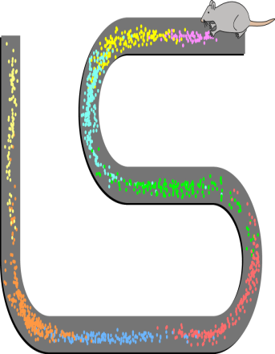
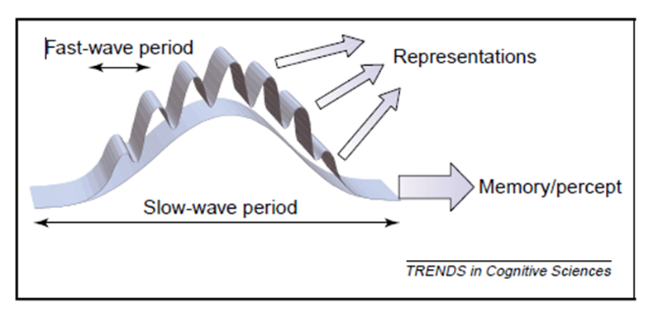
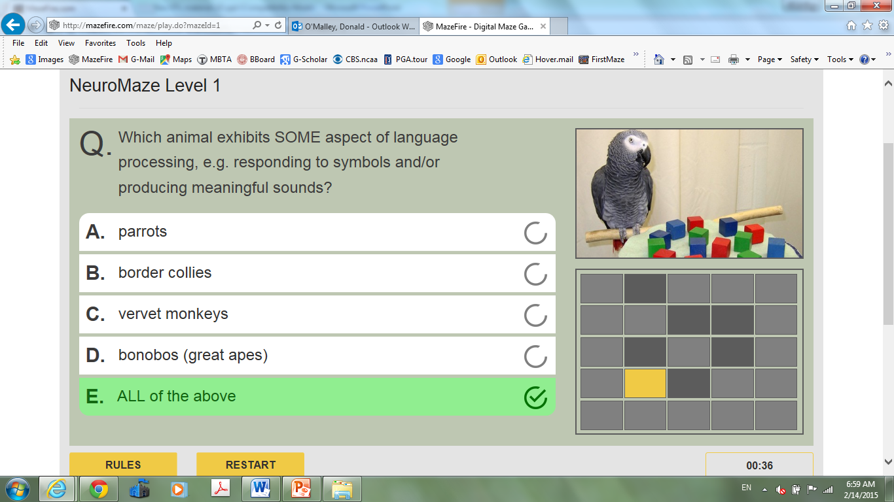
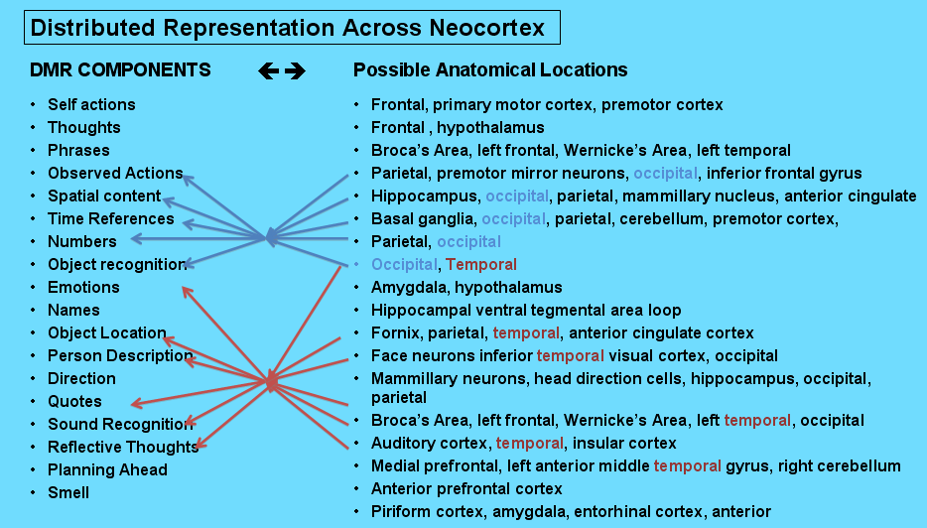
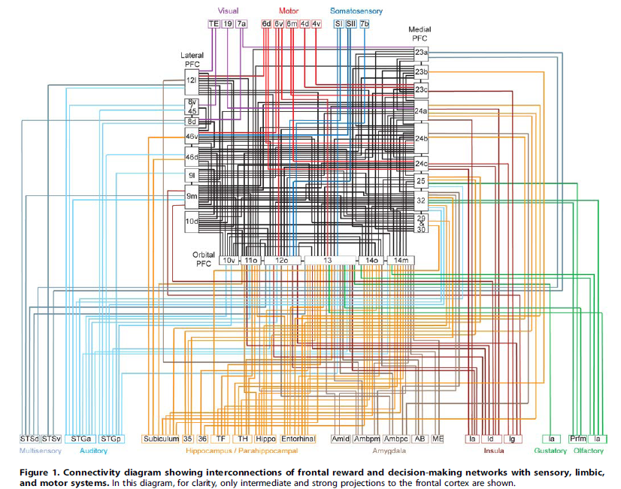
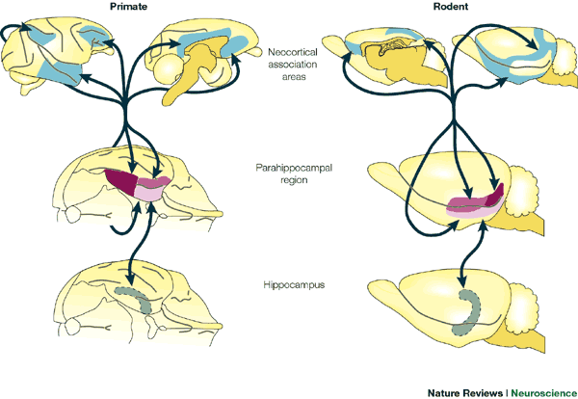
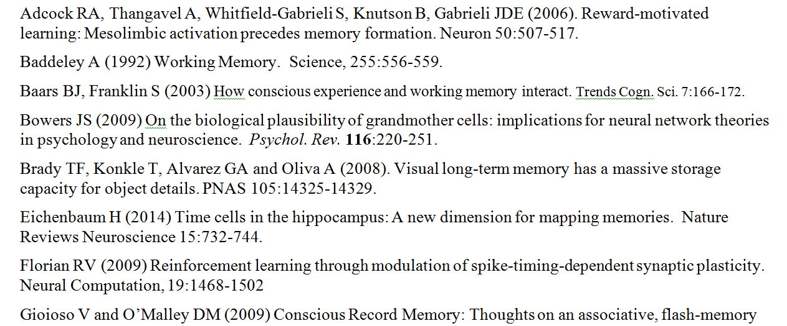
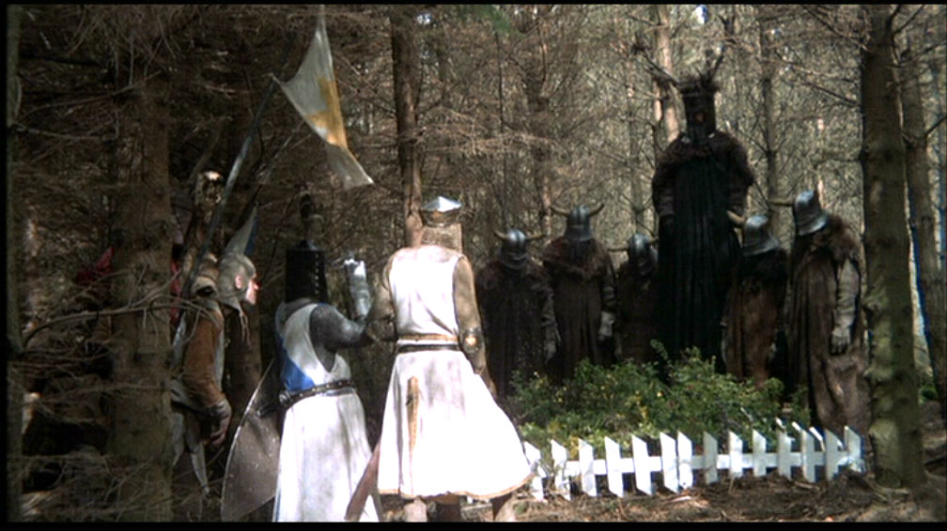
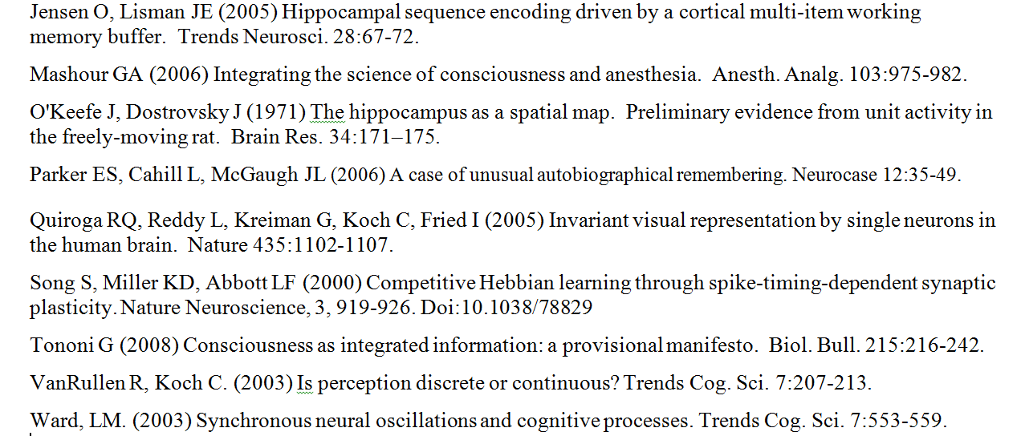
The dogs may bark, but the caravan
moves
on
2015 Neuron Conference
Quinnipiac University
North Haven CT, 2/22/15
1. Why Don’t we Run Out of Neurons?
H1: many neurons are currently empty
H2: neurogenesis (unlikely, too few in number)
H3: massive layering / sparse coding
H4: regular reorganization (as happens
with rat “place fields” e.g. at right)
9. Can Active Learning Help?
- extrinsic motivation boosts synaptic activation
- amplified by intrinsic motivation of games, case studies
- neuronal summation (multisensory, connections) ➔ LTP
- active learning elicits knowledge integration as in #8
- SLT framework might inspire new A.L. approaches?
Place Cell article
on Wikipedia
for Network Capacity Limits see T. P. Trappenberg’s Computational Neuroscience
2. How does NEW knowledge enter our brains?
- some enters via Working Memory in Prefrontal Cortex
- but most is Long Term Memory, requires hippocampus
see e.g. LTP, patient HM; but location of EM buffer is uncertain
- all Declarative Knowledge passes through Conscious
Experience and Daily Memory Records (DMRs)
Memory Storage via γ on θ rhythms, Lisman & Idiart, 1995
VISIT: www.mazefire.com for
neuro, bio, physiology games
Rat Hippocampus
Santiago Ramon y Cajal
10. HOCs Rock! [Higher Order Correlations]
- within DMRs (correlations between DMR epochs)
- SCIP scanning of knowledge architectures for best fits
- roles for hippocampus, Bayesian inference? J. Tenenbaum
- percolation theory and Auto Associative Networks
- cortical proofreading mechanisms (www.syndar.org)
3. What is a Daily Memory Record?
- chronological excerpt of conscious experience
- one-trial, effortless day-long memory record
- capacity is dependent upon past experiences
Digital Maze Games use Intrinsic Motivation to boost synaptic learning
MEDscience cases are Active and Multi-Sensory
8. How is NEW Knowledge Integrated?
- role of SCIP ϟ Sub-Conscious Information Processing
- valuation of connections in trans-neuronal representations
- expansion and enrichment of Knowledge Architectures
- how are new CONCEPTS created?
- role for Symbolic Neuronal Operations (SNOPs)?
- percolation for Pavlovian-connections & processing?
STREAM OF
CONSCIOUSNESS
DMR
Synaptic Learning Theory: Linking Cortical
Network Events to Cognitive Advancement
Annie G. Bryant AND Donald M. O’Malley
Behavioral Neuroscience Program & Dept. Biology, NU, Boston MA
INTEGRATED
PERCEPT
200 msec to
consciousness via
gamma oscillations
CGM / FILTER
consciousness-
generating
machinery
Ganz & O’Malley, 2012
Précis of SLT The goal of SLT is to chart a path from synaptic and neuronal-level events, through SNOPs (symbolic neuronal operations) to conceptual advancement and knowledge integration. Because ALL learning is synaptic in nature (including working memory, perception and auto-associative network creation), a principled understanding of how synaptic and local-circuit events relate to import of new knowledge tokens (items) is the first step on this path. Higher-level and longer-term events, e.g. assigning value to DMR epochs and modifying existing knowledge architectures to accommodate new information, require a deeper understanding of both cognitive and limbic processes, which are inherently computational in nature. For now, we hope that SLT will inspire better educational tools that are more engaging and fun for students of all ages. coming soon: Synthetic Neuroscience Institute: d.omalley@neu.edu
SENSORY INPUTS
neocortical SIGNALS
Bottom-Up
Top-Down
see On Intelligence (Hawkins) and Baars & Franklin (2003, 2005, 2007)
Bound items in DMRs relate to diverse, trans-cortical representations involving
many parts of neocortex. Hippocampus might sequence epochs via γ on Φ rhythms.
4. What do DMR epochs look like?
- trans-cortical representations (see items #6, #8)
- binding depends on alpha & gamma-band oscillations?
- largely non-linguistic in nature: “knowledge tokens”
7. How does Language relate to Knowledge?
- words, by themselves, mean nothing
- words and phrases: just “tags” for non-linguistic items?
- universal grammar is built upon universal physics
aka evolutionarily deep objects, actions, relationships
- language offers fully symbolic operations, BUT
- sub-linguistic SNOPs might entail massive SCIPs
DMR Items, Frequency of Item Occurrence
6. How is Knowledge Represented?
- invariant representations of knowledge tokens
- distributed, massively interconnected assemblies
- “dense coding” ala Quiroga’s Jennifer Aniston cells
- symbolic “neural words” (~ neural “PDFs”)?
- Knowledge Architectures built of atoms, molecules,
to larger structures (proteins, cells, by analogy)
Ganz and O’Malley, 2012
@ www.zfhindbrain.com
5. What exactly DO we RECORD and SAVE?
- “salience / novelty” = first pass “filter” into SoC
- from SoC, 2nd filter evaluates and stores epochs
- of ~ 15,000 epochs per day (= 1 DMR) only a small
subset are consolidated into long-term memory
- epochs might be assigned value by comparison to
stored, related items = 3rd filter
- subconscious IP, sleep & hippocampus all contribute
Pulvermüller & Fadiga, 2010, NRN
Bruno Averbeck &
Moonsang Seo, 2008
Are DMRs stored in the temporal / parietal / prefrontal cortices?
PLoS Computational Biology
Consc. Epochs see VanRullen & Koch (2003); Alpha/Gamma see Ward (2003) in Trends in Cogn. Sciences
see Rilling et al. 2008,
Nature Neuro. 11:426.
Howard Eichenbaum
Nature Reviews
Neuroscience, 2000.
Suggested
Readings
Rilling showed, in humans, enhanced trans-cortical STS connectivity which might facilitate fully symbolic neuronal operations (SNOPs) aka Language.
Cortical-
Hippocampal
System for
Declarative
Memory
We WANT
a PATH!
From Stream of Consciousness (SoC) we RECORD into DMRs
Excerpts of DMRs are SAVED into Long Term Memory (LTMs)
Rats store contextual LTMs that require an intact hippocampus
Do rats have DMRs? Just ask one! or see Eichenbaum and Fortin, 2003
Most learning/memory is Hebbian, but this requires coincident firing
Diagram illustrates trans-cortical connectivity and emphasizes prefrontal
cortex as a massive hub through which all manner of representations might bind.
See Quian Quiroga et al. 2005
Notes:
1

